Slide 1

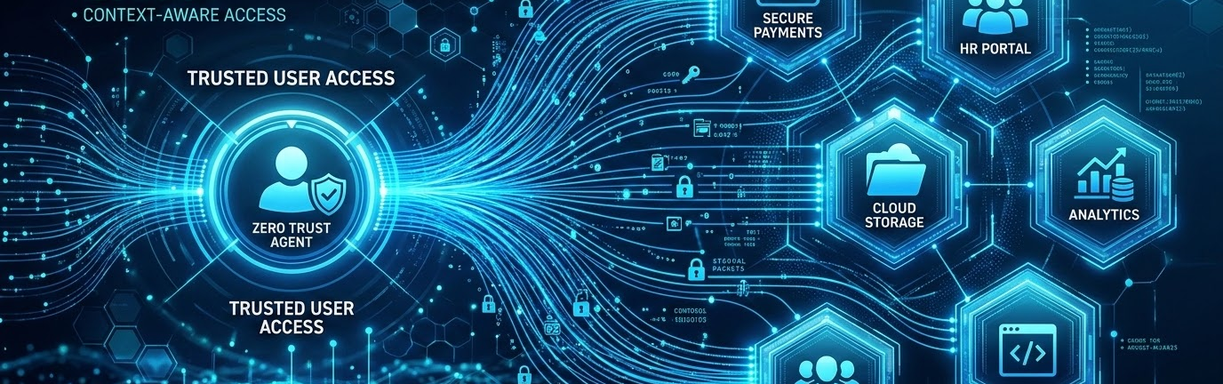
Difference Between VPN & Zero Trust
Traditional VPN
Perimeter-Based Tunnel
Zero Trust Architecture
Continuous Micro-Verification
LAB
Cross Functional Learning Lab
PRESENTER
Baishnabi Samal
DATE
July 2, 2026

Slide 2


Agenda
Overview of the session modules covering modern network security paradigms.
01
What is VPN?
Understanding traditional perimeter security and virtual private networks.
02
What is Zero Trust?
Introduction to continuous verification concepts and identity-driven access.
03
Key Differences
Direct comparison of core principles, access levels, and security posture.
04
Architecture
Comparing perimeter tunnels with micro-segmented app-specific access.
05
Real-world Example
Analyzing threat models, breach scenarios, and enterprise deployments.
06
Pros & Cons
Evaluating the operational trade-offs, advantages, and limitations of both.
07
When to Use Which?
Decision matrix based on organizational size, compliance, and infrastructure.
08
Conclusion
Final takeaways and best practices for modern security migration.
LAB
Cross Functional Learning Lab
PRESENTER
Baishnabi Samal
DATE
July 2, 2026

Slide 3

What is a VPN?
A Virtual Private Network (VPN) creates an encrypted tunnel between a user's device and the organization's network.
Key Advantages
✓ Encrypts internet traffic
✓ Secure remote access
✓ Easy to deploy
How It Works
Limitations & Risks
✗ Broad network access risk
✗ Vulnerable if credentials compromised
✗ Trusts users implicitly after login
01
User Authenticates
02
Tunnel Created
03
Network Access
04
Resources Reachable
LAB
Cross Functional Learning Lab
PRESENTER
Baishnabi Samal
DATE
July 2, 2026

Slide 4


What is Zero Trust?
A security framework based on the core principle of "Never Trust, Always Verify," replacing legacy perimeter assumptions.
CORE PRINCIPLES
COMPONENTS
Verify every user
Verify every device
Least privilege access
Continuous monitoring
Identity Provider
MFA
Device verification
Policy Engine
Examples:
Okta
Microsoft Entra ID
Keycloak
InstaSafe
LAB
Cross Functional Learning Lab
PRESENTER
Baishnabi Samal
DATE
July 2, 2026

Slide 5
VPN vs Zero Trust Comparison
Feature
Traditional VPN
Zero Trust Architecture
Access Scope
Broad Network Access
App-Specific Micro-Segmentation
Trust Model
Implicit Trust After Login
Continuous Verification (Never Trust)
Authentication
Username / Password (Static)
MFA + Context-Aware Identity
Security Posture
Medium (Perimeter-reliant)
High (Fully-segmented)
Device Integrity Check
Usually No
Yes (Strict Compliance & Health Checks)
Least Privilege Access
Limited (Vulnerable to Lateral Movement)
Yes (Granular App Policies)
Monitoring & Audit
Basic Logins Only
Continuous Session & Behavior Analytics
LAB
Cross Functional Learning Lab
PRESENTER
Baishnabi Samal
DATE
July 2, 2026

Slide 6
Architecture Comparison
Side-by-side visualization of perimeter network tunneling versus modern micro-segmented application access.
Traditional VPN
Zero Trust Architecture
VPN User
Zero Trust User
VPN Tunnel
Identity Verification
Corporate Network
Policy Check
Applications
Application
Full Network Access Granted
Segmented App Access Only
LAB
Cross Functional Learning Lab
PRESENTER
Baishnabi Samal
DATE
July 2, 2026

Slide 7
Real-World Scenario
Traditional VPN
Zero Trust Architecture
01
Employee connects to VPN
01
Opens CRM App
02
Identity verified
03
Device verified
04
Policy checked
02
Gets access to the entire office network
05
Only CRM is accessible
03
Can potentially scan multiple servers
⚠ RISK: High Lateral Movement
✓ Finance servers remain isolated
LAB
Cross Functional Learning Lab
PRESENTER
Baishnabi Samal
DATE
July 2, 2026

Slide 8
Advantages & Challenges
Balancing operational tradeoffs: Comparing legacy perimeter-based systems with identity-driven security architectures.
Traditional VPN
Zero Trust Architecture
ADVANTAGES
ADVANTAGES
Simple deployment & onboarding
Low cost
Familiar
Strong security
Least privilege access
Reduced attack surface & high visibility
CHALLENGES
CHALLENGES
Flat network
High risk of lateral movement after login
Hard to scale securely
Requires extensive planning
High initial setup effort
Identity management required
LAB
Cross Functional Learning Lab
PRESENTER
Baishnabi Samal
DATE
July 2, 2026

Slide 9
When Should You Use Each?
Selecting the right security paradigm: Mapping architecture suitability to enterprise infrastructure and data needs.
Traditional VPN
Zero Trust Architecture
SUITABLE FOR
SUITABLE FOR
Small businesses with simple networks
Temporary or occasional remote access
Legacy applications and static environments
Dynamic hybrid workforces
Cloud-native applications & SaaS
Sensitive business data & IP protection
Modern enterprises requiring high compliance
LAB
Cross Functional Learning Lab
PRESENTER
Baishnabi Samal
DATE
July 2, 2026

Slide 10


Conclusion
Traditional VPN Model
Zero Trust Architecture
PERIMETER FOCUS
VPN protects the network connection, granting broad access.
VPN trusts implicitly once authentication is successful.
IDENTITY & REQUEST FOCUS
Zero Trust protects every single access request and resources.
Zero Trust continuously verifies all users and devices.
“Zero Trust does not replace encryption provided by VPNs—it changes the security model by verifying every access request instead of assuming trust after connection.”
LAB
Cross Functional Learning Lab
PRESENTER
Baishnabi Samal
DATE
July 2, 2026

